Slide 1
ADO .NET
The DataAdapter & the DataSet

Slide 2
Command Class Review
A class we use to retrieve information from the database
A class we use to insert, update or delete information from the database
Complex class that makes use of other classes including the Connection class and the Parameter class

Slide 3
Command Object her slide
Command
Connection
Conn String
Reference Variable
Command Text
Parameter
Parameter
Collection
Parameter
Parameter

Slide 4
Using the SqlCommand Class
selectCommand
Our reference variable used as a pointer to: SqlCommand instance
Class: SqlCommand
SqlCommand Class instance:
Constuctor (commandtext, connection object)
String property: .CommandText string sqlstring "Select ..”
Object property: .Connection SqlConnection Conn
ParamList property: .Parameters List of objects of type SqlParameter
Class: SqlConnection
SqlConnection Class instance:
String property: .ConnectionString =
@"Server=localhost\SqlExp…
List<SqlParameter>
param1
param2
...

Slide 5
That technology sends one command to the SQL server for every row of data you read.
Our next topic uses a technology that
In one operation, copies all the data you ask for into an in-memory representation
The in-memory representation lets you manipulate the data as C# objects (x.y.z) instead of Indexer reader[“FirstName”]
As you modify the data, add, or delete it, this technology will keep track of the changes, and write them back to the database when you are done.
It’s a bit of a hassle to set up, but it works very nicely.

Slide 6
DataAdapter Class
A class we use to retrieve information from the database
A class we use to insert, update or delete information from the database
Complex class that makes use of other classes including the Command class

Slide 7
Retrieving Data
DataAdapter
SQL
Data
DataSet

Slide 8
DataAdapter
Sends SQL to the database
Retrieves a set of data and places it in a client side repository (the DataSet or DataTable within the DataSet)
Can also send SQL to insert, update, delete from the database

Slide 9
DataAdapter:Retrieving Information
Class: SQLDataAdapter
Properties:
SelectCommand (our friend, the Command object)
Methods:
Fill

Slide 10
DataAdapter Object
DataAdapter
Connection
Command
Conn String
Reference Variable
Command Text
Parameter
Parameter
Collection
Parameter
Many levels of aggregation
Use intellisense.
Parameter

Slide 11
DataSet
The class that represents relational data on the client-side
In-memory representation of data from the database
Object-oriented representation of relational data
Complicated class containing many collections
Tables
Rows
Columns
Data Relations
…

Slide 12
DataSet
Database independent
Does NOT provide presentation
Windows controls or Web controls are needed for presentation

Slide 13
ADO .NET
System.Data.SQLClient namespace
Classes specific to accessing SQL Server
System.Data.OleDb namespace
Classes to access most relational databases
System.Data
Classes that are not database specific
DataSet

Slide 14
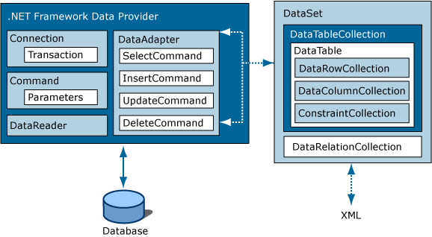
ADO .NET Architecture
Excerpted from the Visual Studio Help Files

Slide 15
DataSet
Two Types:
Un-Typed***
No definition of structure prior to data being retrieved from the database
Provides “ultimate” flexibility
Typed
XML schema defined at design time
Schema definition allows classes to be created that provide design time checking

Slide 16
Data Retrieval using the DataAdapter & DataSet
Instantiate a DataSet (to hold the data)
Instantiate DataAdapter (interface to SQL)
Configure the DataAdapter
Set up appropriate command object(s)
Invoke the Fill Method of your configured DataAdapter (gets data from SQL, loads DataSet, we don’t have to do an Open)
Display/process the data in the DataSet or DataTable

Slide 17
Displaying Data
Namespace: System.Windows.Forms
Class: DataGridView
Properties:
DataSource
DataMember
DataGrid
DataSet

Slide 18
Summary
DataAdapter – Communicates with the database
DataSet – stores relational data
UI classes (e.g. DataGridView) display data in the DataSet
(writing data back to SQL takes a lot more stuff, we’ll get to that later.)

